Slide 1



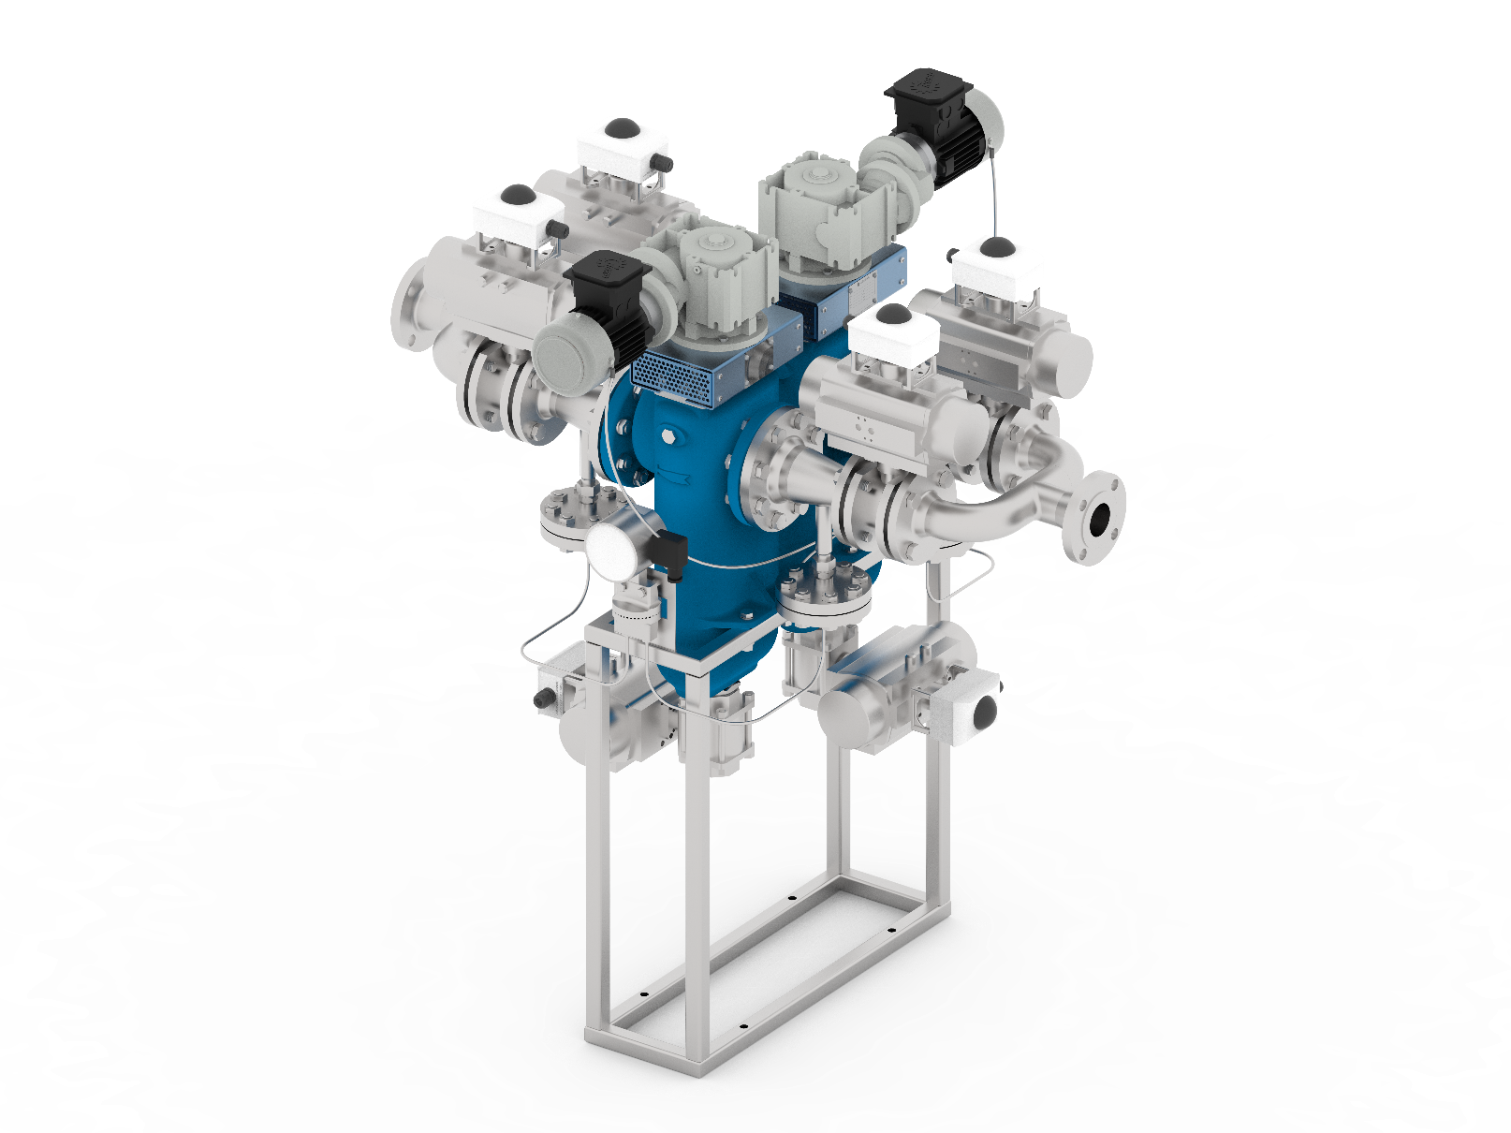





SCAMDISC
Self-cleaning filtration
French manufacturing
Filtration of viscous products: fuel oils, tars, glues, oil residues, paints, resins, molasses...
Continuous self-cleaning systems without interruption of the flow to be filtered
Reduced maintenance and operating costs
Interchangeable and re-conditionable filter element
Low pressure drop
Standard and made-to-measure range
CONFIGURATION
Manual or Automatic
Single or Multi-element
Suction and discharge operation
0000
TERMS OF SERVICE STANDARD*
BUILDING MATERIALS
EQUIPMENT
(Standard or Atex)
Min. filtration threshold 50µm
Standard or special control box on request
Flow rate 0 to 50 m3/h
Filter housing
Cast iron, bronze, carbon steel and stainless steel
Purge valve
Pneumatic or Electric
Temperature 0 to 90°C
Filter element
Carbon steel, stainless steel
Max. pressure 10 bar
Differential pressure gauge
With or without separator
Viscosity max. 600 cSt
Seals
On request
Divers équipements sur demande
Isolation valve, Insulation, Temperature measurement, etc...
* If your process conditions exceed these limits, we will study your specific needs and provide you with a tailor-made study.
Complies with the European Directive 2014/68/EC

Slide 2

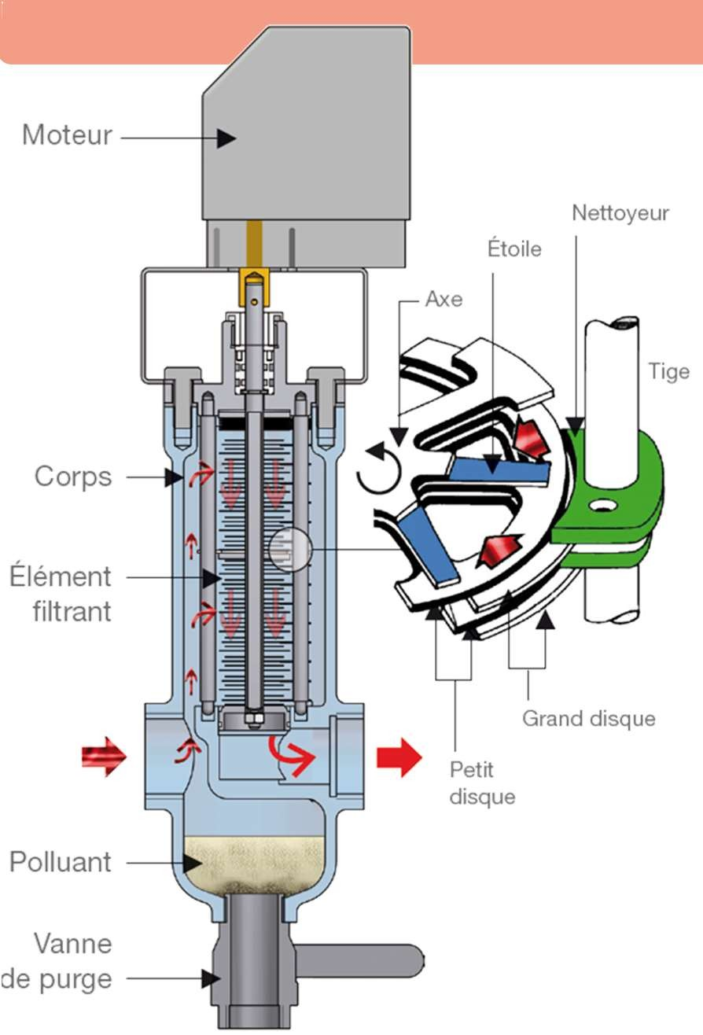






FILTER OPERATION
The filtering element is a stack of metal discs separated from each other by wedges (stars) whose thickness sets the filtration threshold.
When the fluid passes between the discs, the solid particles it contains and of a size greater than the filtration threshold are therefore stopped on the outer periphery of the discs.
The stack of discs is rotated (manually or motorized) allowing the cleaners to scrape the periphery of the discs and thus dislodge the pollutants.
Draining the filter allows contaminants to be removed; its frequency is determined according to the quantity of pollutants contained in the fluid.
Engine
Cleaner
PETROCHEMICALS
Star
Axe
Stem
HEATING CIRCUITS
Corps
CIMENTERIE
Filtering elements
GLASSWARE
Large disc
Small disc
ENERGY
Polluant
OIL & GAZ
Purge valve
Find our news on www.pemflow.fr

Slide 3
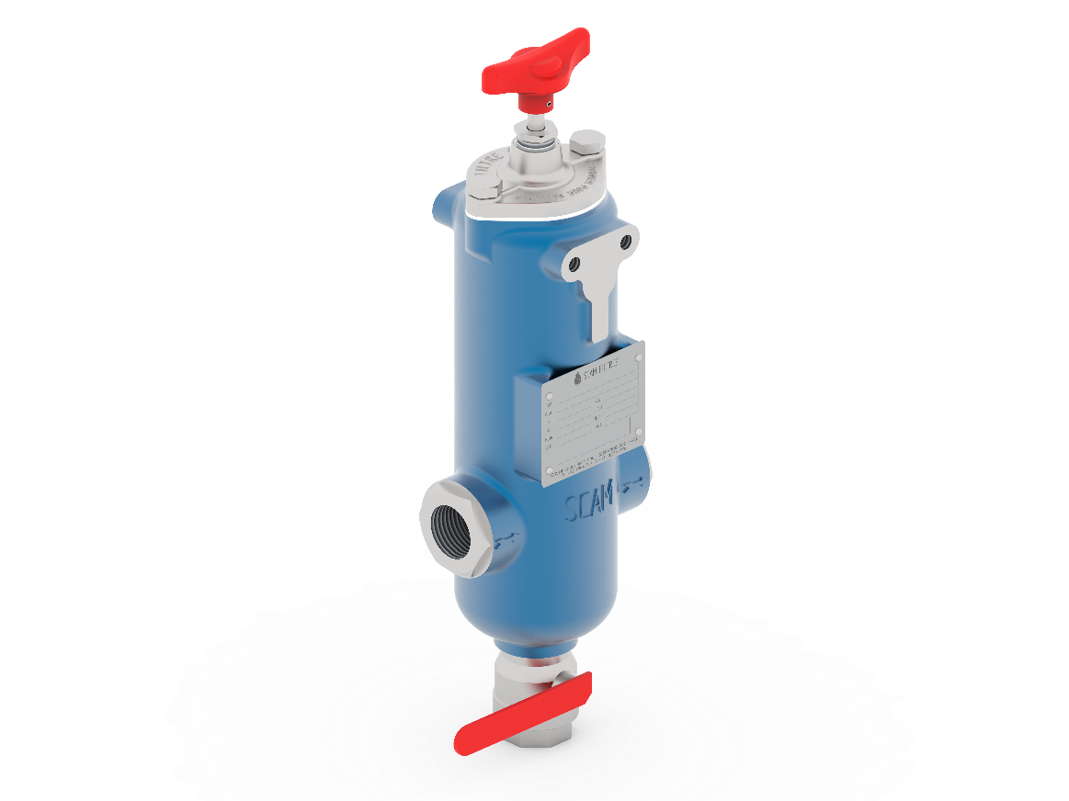
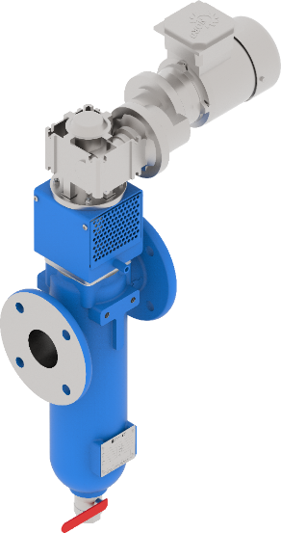
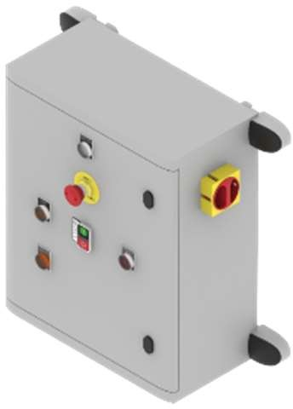
STANDARD RANGE
Viscosity (cSt) | Flow rate L/h
 | 34-135 50µ | 34-135 250µ | 34-135 500µ
Water | 2900 | 5000 | 5400
21 at 53 | 2720 | 4800 | 4350
53 at 115 | 2020 | 4000 | 4100
115 at 190 | 1090 | 3000 | 3120
190 at 305 | 640 | 2600 | 2800
305 at 406 | 470 | 2000 | 2200
160 at 610 | 280 | 1600 | 2000
Viscosity (cSt) | Flow rate L/h
 | 52-192 50µ | 52-192 250µ | 58-192 500µ
Water | 7000 | 15500 | 1600
21 at 53 | 5500 | 14000 | 14500
53 at 115 | 3800 | 10600 | 13000
115 at 190 | 1700 | 7900 | 11700
190 at 305 | 1150 | 6450 | 11000
305 at 406 | 800 | 4600 | 8800
160 at 610 | 600 | 3700 | 8000
Viscosity (cSt) | Flow rate L/h
 | 2MF52-256 50µ | 2MF52-256 250µ | 2MF58-256 500µ
Water | 18620 | 41230 | 42560
21 at 53 | 14630 | 37240 | 38570
53 at 115 | 10108 | 28196 | 34580
115 at 190 | 4522 | 21014 | 13122
190 at 305 | 3059 | 17157 | 29260
305 at 406 | 2128 | 12236 | 23408
160 at 610 | 1596 | 9842 | 21280
Find our news on www.pemflow.fr

Slide 4
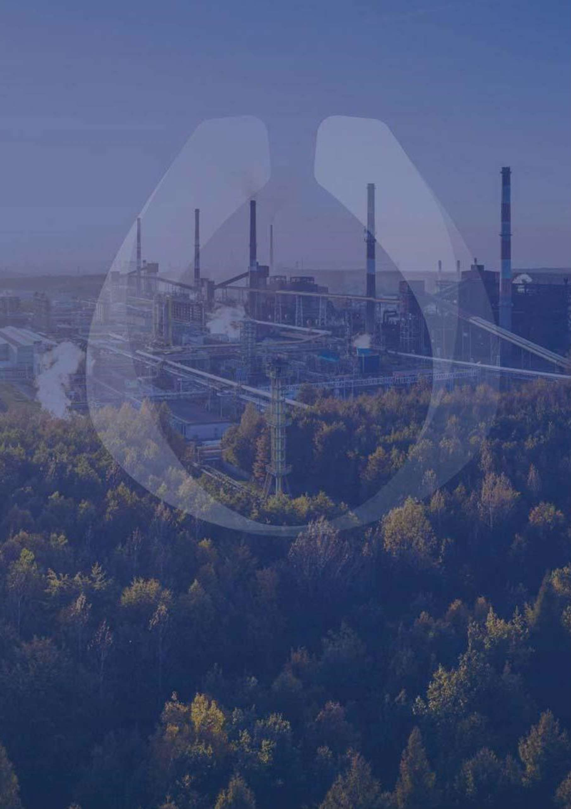



Let's keep in touch
382, rue de Bondues
Parc d’Activités du Moulin, Zone B 59118 WAMBRECHIES
adv@pemflow.com
+33 3 20 66 27 07

