Slide 1
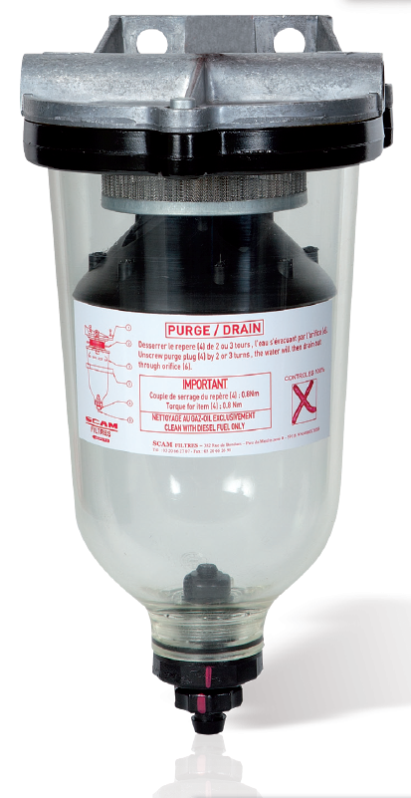
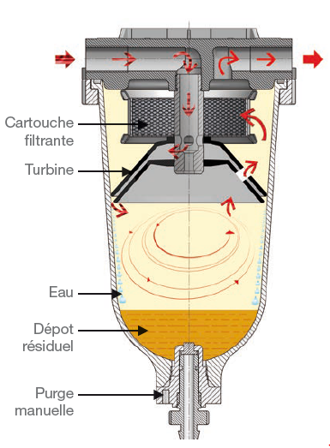
Fuel pre-filtration
VTX
Easy maintenance: quick removal and easy cleaning of the cartridge
Minimum space requirement
High reliability: no moving parts
No consumables
Good corrosion resistance
Good impact resistance
French manufacturing
FILTER OPERATION
Separation of water from fuel by centrifugation for the optimization of the coalescence phenomenon
Final filtration of solid particles on the metal cartridge
NAUTICAL
AUTOMOBILE
AGRICULTURE
SKID
0000
Operating conditions
CONFIGURATION
Filtration threshold
100, 300 and 500µm
Max. flow rate
500 l/hr
Temperature
-15 to 50°C
Pressure loss
15 mbar
In and output M14x1,5
Nitrile gasket (VITON option)
Aluminum alloy cover
Stainless steel cartridge
Polypropylene turbine
Transparent Trogamid bowl
Complies with the European Directive
2014/68/EC

Slide 2
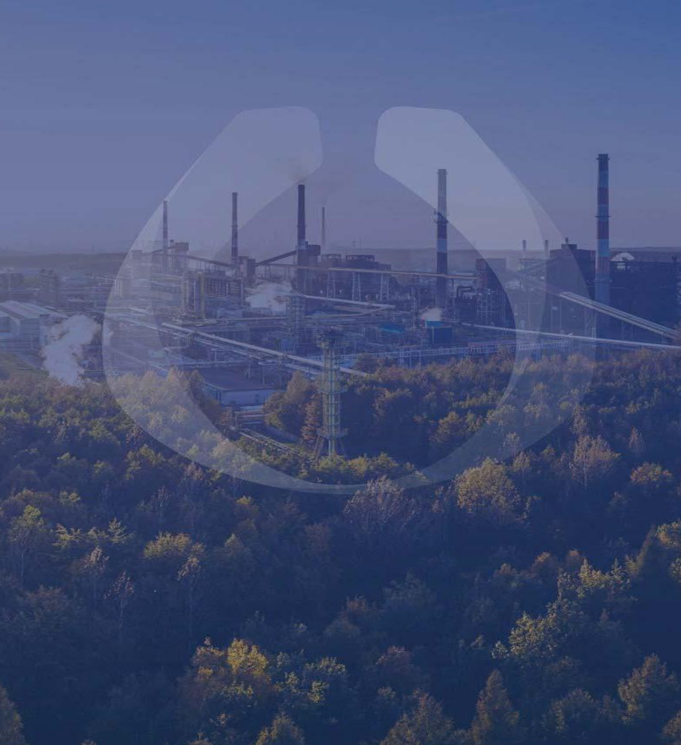
Let's keep in touch
382, rue de Bondues
Parc d’Activités du Moulin, Zone B
59118 WAMBRECHIES,
FRANCE
adv@pemflow.com
+33 3 20 66 27 07

